Slide 1
Managing HIV Tester Certification Data

Slide 2
Learning Objectives
At the end of the session, you will be able to:
  Understand what constitute the certification data
  Describe what are the key elements of the certification data management process
  Understand the purpose of the certification data management tool
  Describe the different components of the certification data management tool

Slide 3
Module Contents
Different type of certification data
Key elements of the certification data management process
Purpose of the certification database
Different component of the certification database

Slide 4
Type of Certification Data
Provider information
  Name
  Geographic location
  Affiliation
  Contact
  Contact of person in charge
Training information
  Type of training
  Training organization
  Trainer(s)
  Training certificate
Examination
  Written exam
  Practical exam
  Examiner/Proctor
  Number of attempts
Certification
  Type of certification
  Certification Issuer
  Date of issuance
  Recertification reminder email
  Recertification information

Slide 5
Key Data Management Areas
Data collection/capture
  Registration sheet
  Written and practical examination documentation
  Database (Excel)
Data Quality
  Review/Quality check
  Double entries
  Validation
Data Access
  National: MOH
  Council: Registrar, Data clerk/manager
  Mid-level: Evaluator, Proctor, data clerk
  Site: Tester
Data Security
  Transport
  Electronic transfer
  Storage / Archiving
    Physical
    Electronic

Slide 6
Managing the Certification Data
1. Collect
2. Review
Registration sheet, written examination sheet and practical examination result forms
Direct observation checklists
Written examination questions + answer key
3. Transport
All paper tools containing tester information examination data
4. Check
Written examination questions + answer key
All paper tools containing tester information examination data
5. Transfer
All paper tools containing tester information examination data
Completeness and accuracy
At regional level: Transfer Into database all paper based data collected
To Council: Transfer all electronic data captured every month

Slide 7
Certification Data Management Tool
Purpose: Design to management certification data for documentation, monitoring and evaluation purpose
Contains four worksheets
  Instructions
  Tester Demographic information
  Tester Training information
  Tester Competency and Certification information
User
  Regional: Evaluator, data clerk
  National/Council: Registrar, data clerk

Slide 8

Tab 1. Instructions

Slide 9
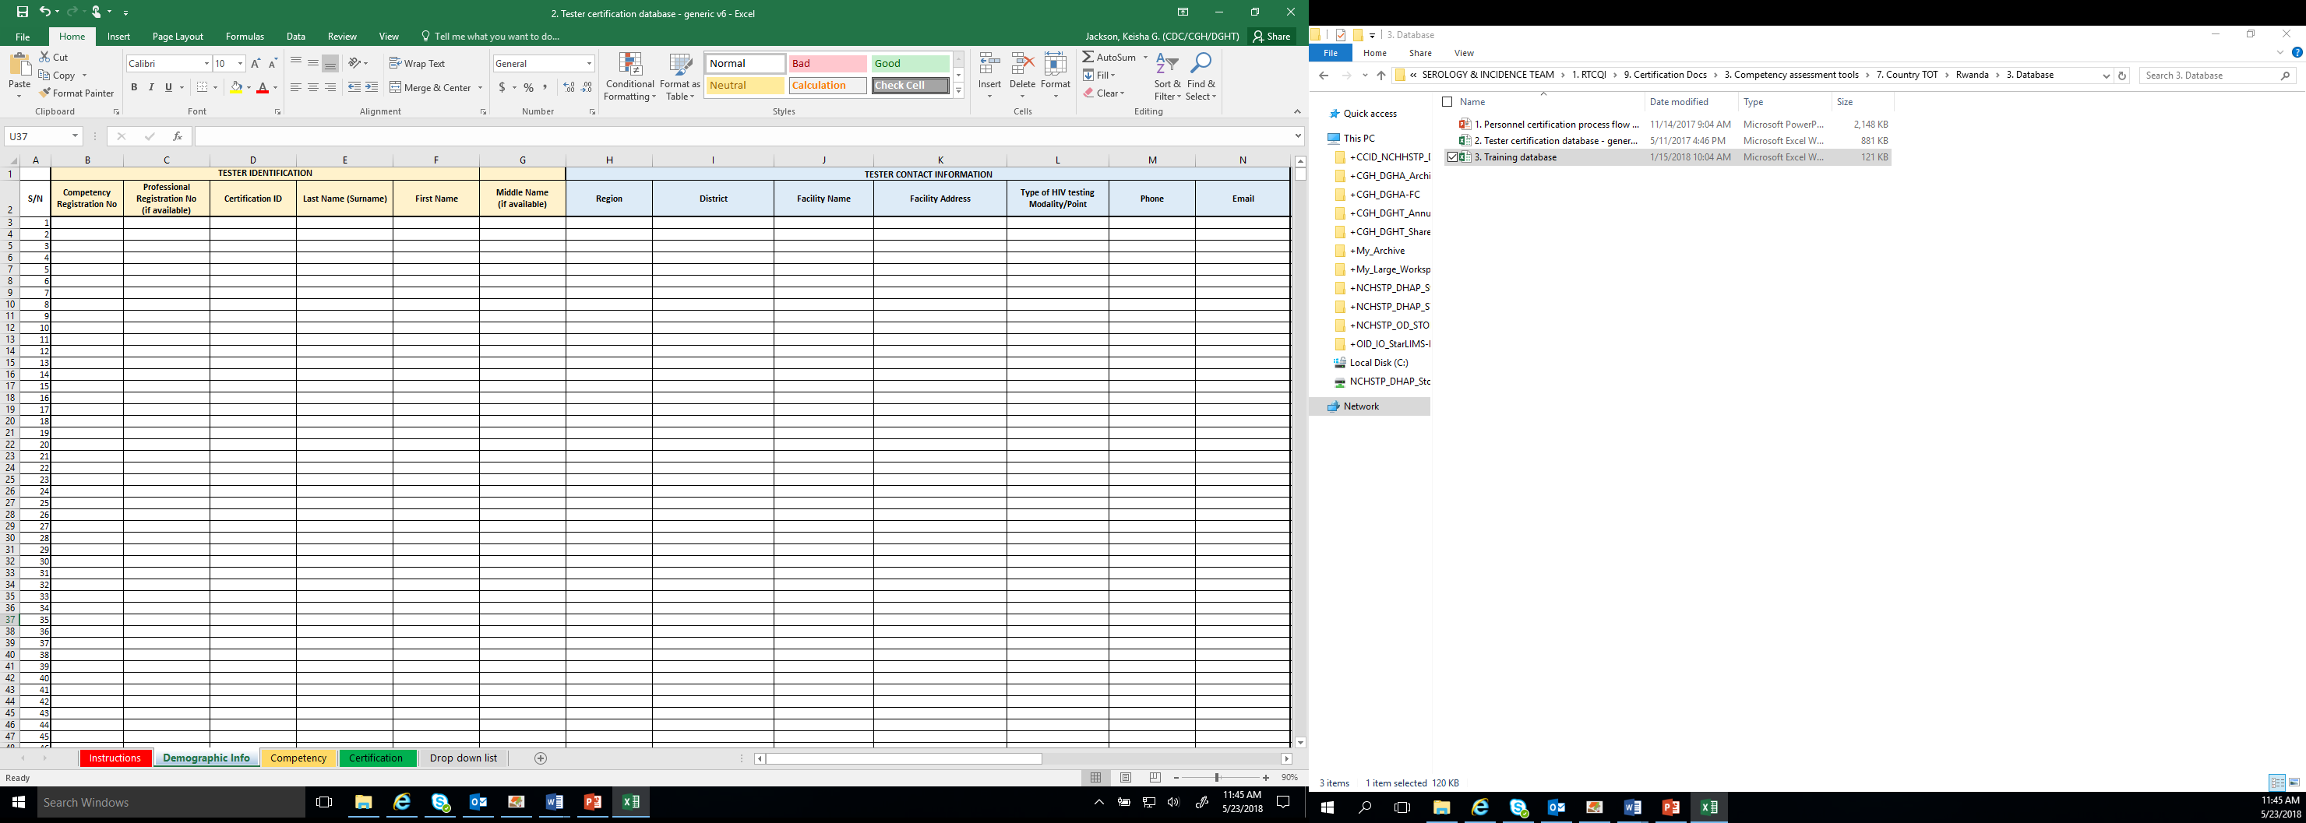
Tab 2. Tester Demographic Information

Slide 10
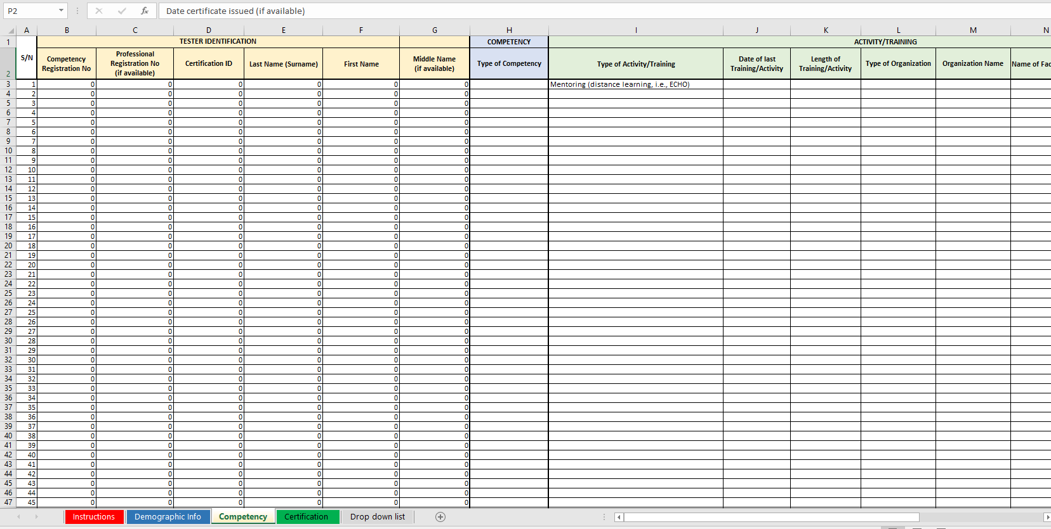
Tab 3. Tester Training Information

Slide 11
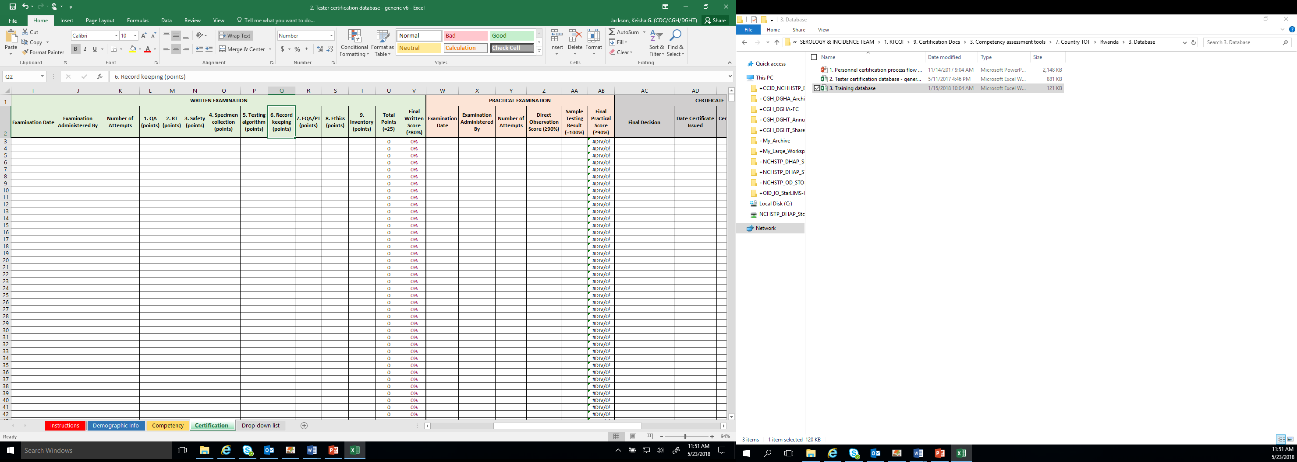
Tab 4. Tester Competency Assessment and Certification Information

Slide 12
Summary
What the different types of certification data?
What are the key elements of the certification data management process?
What is the purpose of the certification data management tool?
What are the different components of the certification data management tool?

